Slide 1

Lead Scoring Case Study 18th July 2023
Sandeep S, Sanjay SH, Sanjay K

Slide 2
Problem Statement
X Education, which sells online courses to industry professionals, gets a lot of leads through multiple sources. However, the lead conversion rate is very poor. For example, if, say, they acquire 100 leads in a day, only about 30 of them are converted.
Business Objective:
Assist X Education in selecting the most promising leads, i.e. the leads that are most likely to convert into paying customers.
Build a model which assigns a lead score to each of the leads such that the customers with a higher lead score have a higher conversion chance ( Hot Leads) and the customers with a lower lead score have a lower conversion chance. (Cold Leads)
Target Lead conversion rate to be around 80%.

Slide 3
Solution modeling methodology
Data Cleaning and Data Preparation
Handling Columns with Missing Data
Mapping Binary categorical variables to 0 or 1
Creating Dummy Variables
EDA
Checking for outliers and Removing outliers
Test – Train Split
Feature Scaling
Identifying Correlations
Model Building (RFE based, VIF/ p-value based)
Model Evaluation using Key Metrics
Model Prediction on Test Set
Summary: Identifying the Key Important Predictor Variables

Slide 4
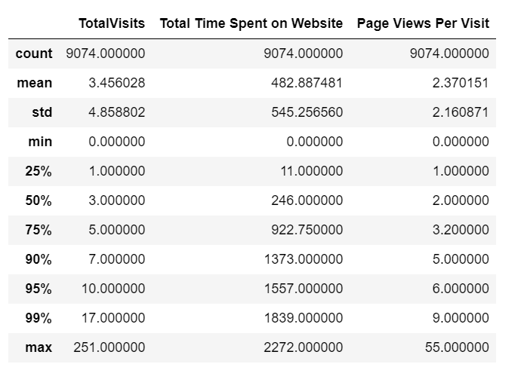
Data cleaning and manipulation
Replaced ‘Select’ in columns with Null values
Columns Dropped Due to High % of Missing Values:
How did you hear about X education?
Lead Profile
City
Country
Asymmetric Activity & Profile Variables
Lead Quality
Tags & What matters most to you in choosing a course – Data is not distributed properly
Imputed Null Values with
‘Others’ for Specialization
‘Unemployed’ for Occupation
Outliers: Picked only the 99% percentile data
‘Total Visits”
‘Page Views per visit’
Outliers

Slide 5
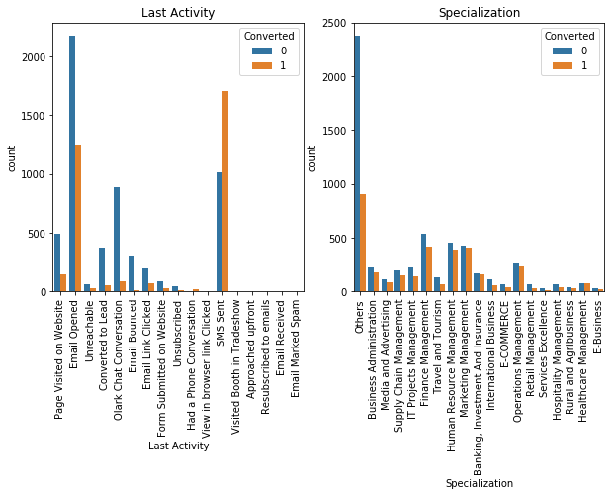
EDA – Categorical variables
Higher Conversion Chances When:
Last Activity is:
SMS is sent
Email Opened
Specialization is:
HR Management
Marketing Management
Operations Management
Finance Management

Slide 6
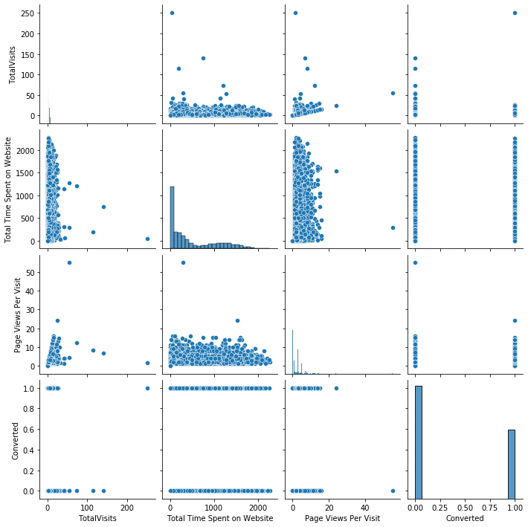
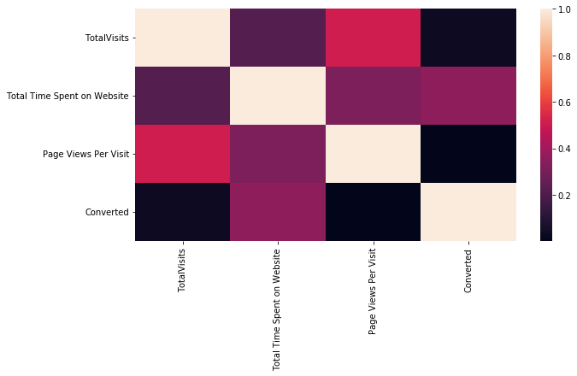
EDA – Numerical variables
Doesn’t seem to be any correlation between the numerical variables

Slide 7
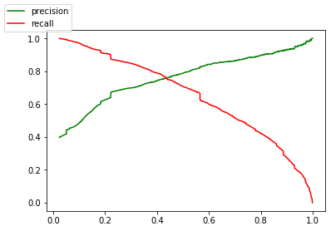
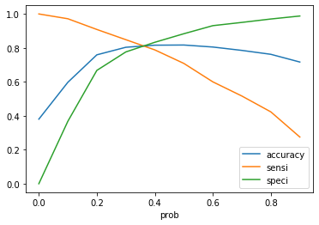
Model Evaluation ROC Curve & Precision – recall tradeoff
0.4 Seems to be the optimal cut off – based on the plots of accuracy, sensitivity and specificity
If Conversion Probability >0.4; Categorise them as Hot Leads (1); Else map them to Cold Leads (0)

Slide 8
Model Evaluation Metrics & Final Feature List Train & Test dAta
Train Data:
Accuracy: 82%
Precision: 74%
Recall: 78%
Test Data:
Accuracy: 80%
Precision: 72%
Recall: 76%
Most Important Attributes or Features with Positive Impact:
Total Time Spent on Website
TotalVisits
Lead Origin_Lead Add Form
Lead Source_Olark Chat
Lead Source_Welingak Website
Last Activity_Had a Phone Conversation
What is your current occupation_Working Professional

Slide 9
Summary
Higher Chances of conversion when the lead is :
Current Occupation as Working professionals
Spend more time on the website
Visit the website repeatedly
Leads who have come from (Lead source or lead origin)
Welingak website
Lead Add Form
Olark Chat
Where last activity was a phone conversation with the lead

